Slide 1
Lecture 4
Multivariable linear regression
Sung Kim <hunkim+ml@gmail.com>
http://hunkim.github.io/ml/

Slide 2
Recap
Hypothesis
Cost function
Gradient descent algorithm

Slide 3


Recap
Hypothesis
Cost function
Gradient descent algorithm

Slide 4
Predicting exam score:
regression using one input (x)
x (hours) | y (score)
10 | 90
9 | 80
3 | 50
2 | 60
11 | 40
one-variable
one-feature

Slide 5
Predicting exam score:
regression using three inputs (x1, x2, x3)
multi-variable/feature
x₁ | x₂ | x₃ | Y
73 | 80 | 75 | 152
93 | 88 | 93 | 185
89 | 91 | 90 | 180
96 | 98 | 100 | 196
73 | 66 | 70 | 142
Test Scores for General Psychology

Slide 6
Hypothesis

Slide 7
Hypothesis

Slide 8
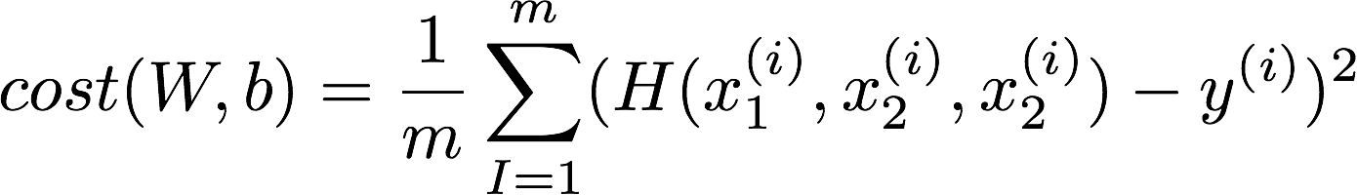
Cost function
Notes:
cost(W,b)=\frac{1}{m}\sum_{I=1}^{m}(H(x_1^{(i)}, x_2^{(i)}, x_2^{(i)})-y^{(i)})^2

Slide 9
Multi-variable

Slide 10
Matrix

Slide 11
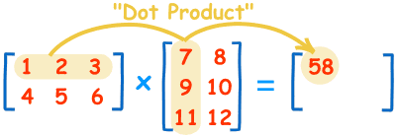
Matrix multiplication
https://www.mathsisfun.com/algebra/matrix-multiplying.html

Slide 12
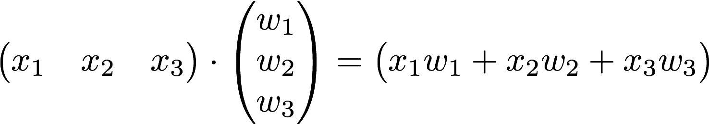

Hypothesis using matrix
Notes:
\begin{pmatrix}x_1&x_2&x_3\end{pmatrix}\cdot \begin{pmatrix}w_1\\ w_2\\ w_3\end{pmatrix}=\begin{pmatrix}x_1w_1+x_2w_2+x_3w_3\end{pmatrix}

Slide 13
Many x instances
x₁ | x₂ | x₃ | Y
73 | 80 | 75 | 152
93 | 88 | 93 | 185
89 | 91 | 90 | 180
96 | 98 | 100 | 196
73 | 66 | 70 | 142
Test Scores for General Psychology
http://college.cengage.com/mathematics/brase/understandable_statistics/7e/students/datasets/mlr/frames/frame.html

Slide 14
Hypothesis using matrix
x₁ | x₂ | x₃ | Y
73 | 80 | 75 | 152
93 | 88 | 93 | 185
89 | 91 | 90 | 180
96 | 98 | 100 | 196
73 | 66 | 70 | 142
Test Scores for General Psychology
https://www.symbolab.com/solver/matrix-calculator
Notes:
\begin{pmatrix}x_1&x_2&x_3\end{pmatrix}\cdot \begin{pmatrix}w_1\\ w_2\\ w_3\end{pmatrix}=\begin{pmatrix}x_1w_1+x_2w_2+x_3w_3\end{pmatrix}

Slide 15
Hypothesis using matrix
x₁ | x₂ | x₃ | Y
73 | 80 | 75 | 152
93 | 88 | 93 | 185
89 | 91 | 90 | 180
96 | 98 | 100 | 196
73 | 66 | 70 | 142
Test Scores for General Psychology
https://www.symbolab.com/solver/matrix-calculator
Notes:
\begin{pmatrix}x_1&x_2&x_3\end{pmatrix}\cdot \begin{pmatrix}w_1\\ w_2\\ w_3\end{pmatrix}=\begin{pmatrix}x_1w_1+x_2w_2+x_3w_3\end{pmatrix}

Slide 16
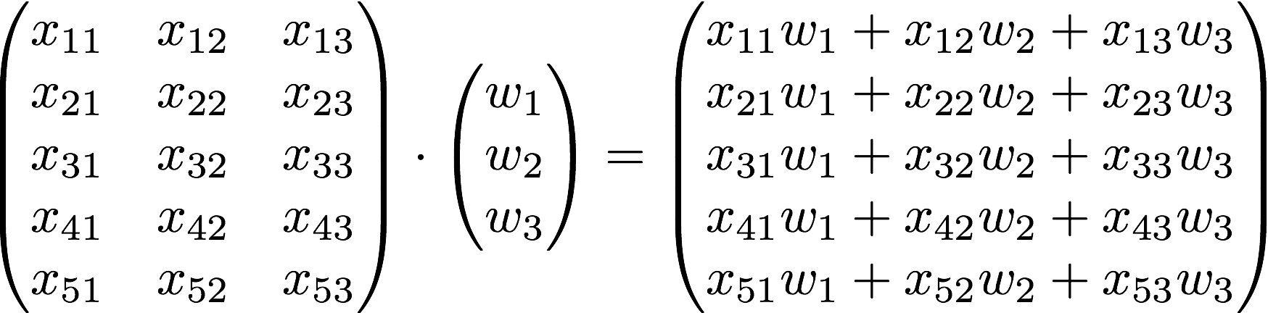
Hypothesis using matrix
x₁ | x₂ | x₃ | Y
73 | 80 | 75 | 152
93 | 88 | 93 | 185
89 | 91 | 90 | 180
96 | 98 | 100 | 196
73 | 66 | 70 | 142
https://www.symbolab.com/solver/matrix-calculator
Notes:
\begin{pmatrix}x_1&x_2&x_3\end{pmatrix}\cdot \begin{pmatrix}w_1\\ w_2\\ w_3\end{pmatrix}=\begin{pmatrix}x_1w_1+x_2w_2+x_3w_3\end{pmatrix}

Slide 17
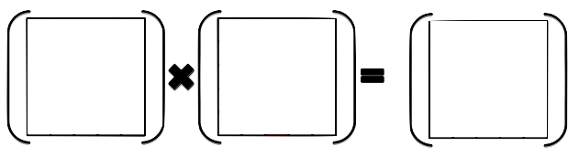
Hypothesis using matrix
[5, 3]
[?, ?]
[5, 1]
Notes:
\begin{pmatrix}x_1&x_2&x_3\end{pmatrix}\cdot \begin{pmatrix}w_1\\ w_2\\ w_3\end{pmatrix}=\begin{pmatrix}x_1w_1+x_2w_2+x_3w_3\end{pmatrix}

Slide 18
Hypothesis using matrix
[5, 3]
[3, 1]
[5, 1]
https://www.symbolab.com/solver/matrix-calculator
Notes:
\begin{pmatrix}x_1&x_2&x_3\end{pmatrix}\cdot \begin{pmatrix}w_1\\ w_2\\ w_3\end{pmatrix}=\begin{pmatrix}x_1w_1+x_2w_2+x_3w_3\end{pmatrix}

Slide 19
Hypothesis using matrix
[n, 3]
[3, 1]
[n, 1]
https://www.symbolab.com/solver/matrix-calculator
Notes:
\begin{pmatrix}x_1&x_2&x_3\end{pmatrix}\cdot \begin{pmatrix}w_1\\ w_2\\ w_3\end{pmatrix}=\begin{pmatrix}x_1w_1+x_2w_2+x_3w_3\end{pmatrix}

Slide 20
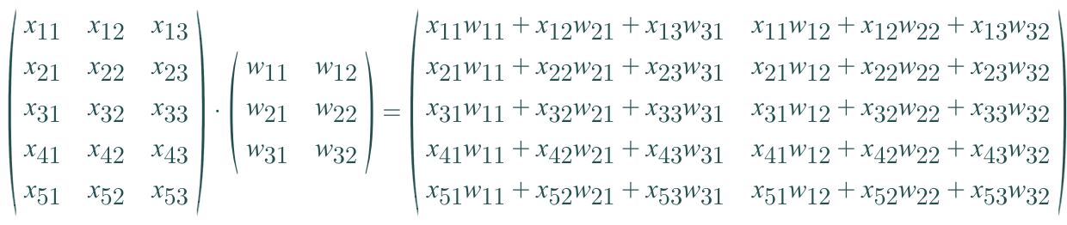
Hypothesis using matrix (n output)
?
[n, 3]
[?, ?]
[n, 2]
https://www.symbolab.com/solver/matrix-calculator
Notes:
\begin{pmatrix}x_1&x_2&x_3\end{pmatrix}\cdot \begin{pmatrix}w_1\\ w_2\\ w_3\end{pmatrix}=\begin{pmatrix}x_1w_1+x_2w_2+x_3w_3\end{pmatrix}

Slide 21
Hypothesis using matrix (n output)
[n, 3]
[3, 2]
[n, 2]
https://www.symbolab.com/solver/matrix-calculator
Notes:
\begin{pmatrix}x_1&x_2&x_3\end{pmatrix}\cdot \begin{pmatrix}w_1\\ w_2\\ w_3\end{pmatrix}=\begin{pmatrix}x_1w_1+x_2w_2+x_3w_3\end{pmatrix}

Slide 22
WX vs XW
Lecture (theory):
Implementation (TensorFlow)

Slide 23

Next
Logistic Regression (Classification)

Slide 24
Backup slides

Slide 25
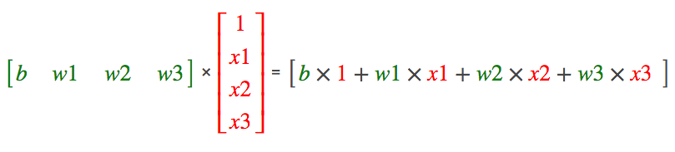

Hypothesis without b

Slide 26
W vs X

Slide 27
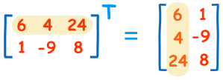
Transpose
http://www.mathsisfun.com/algebra/matrix-introduction.html

Slide 28

Hypothesis using Transpose

Slide 29
Next
Logistic Regression (Classification)

